Slide 1

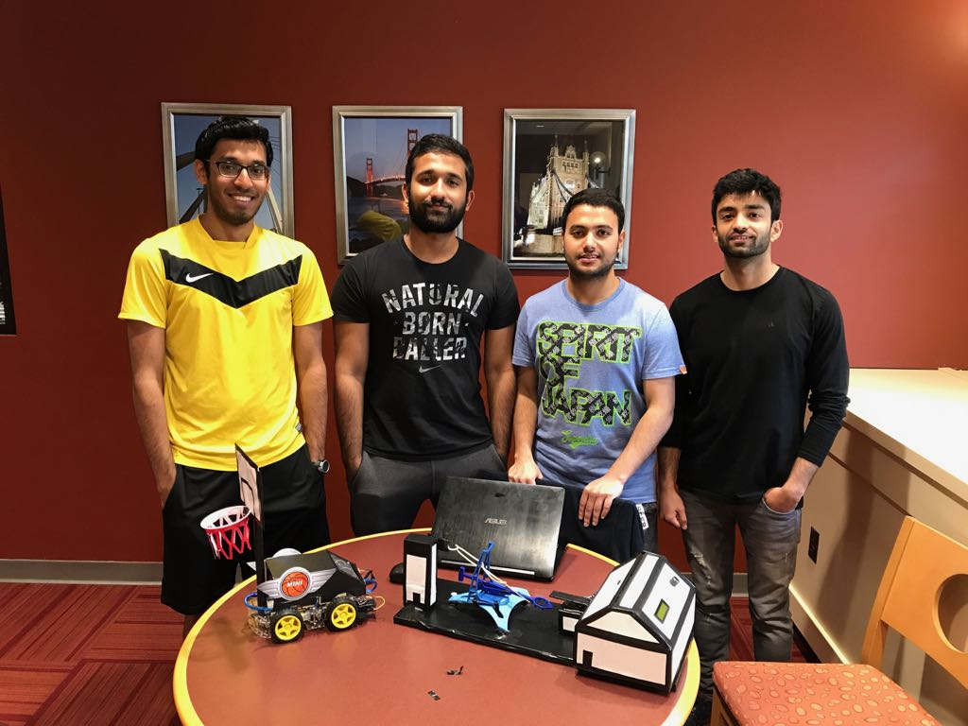
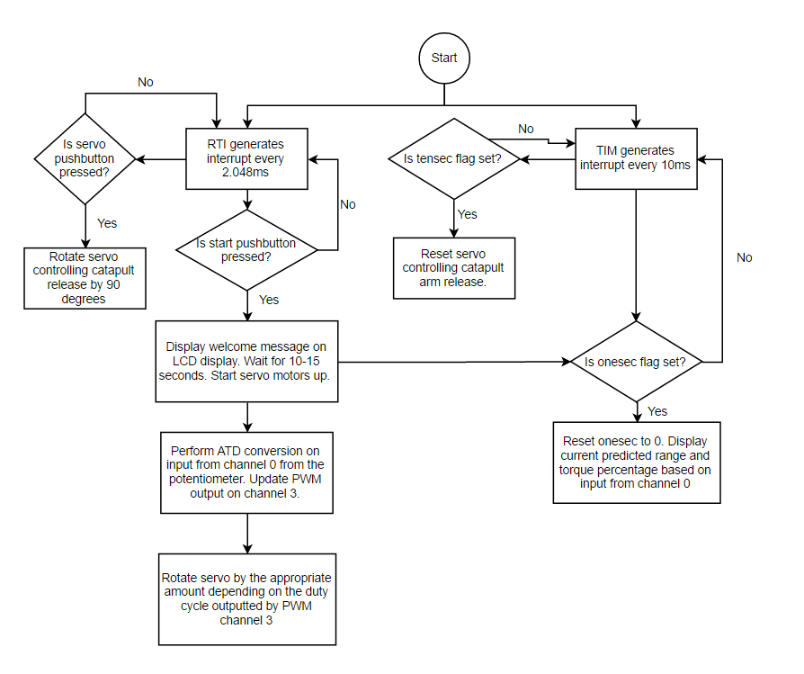
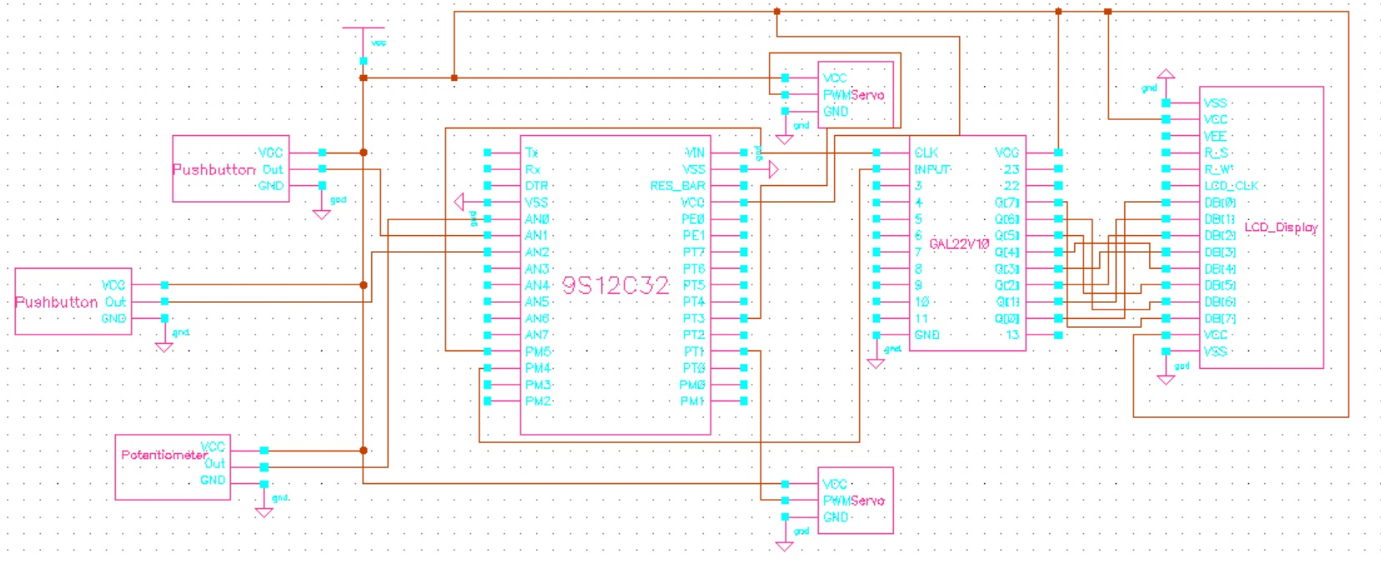
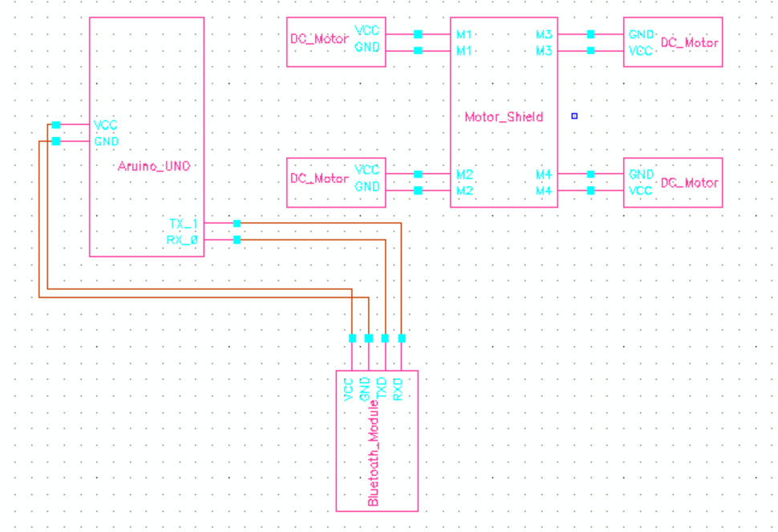
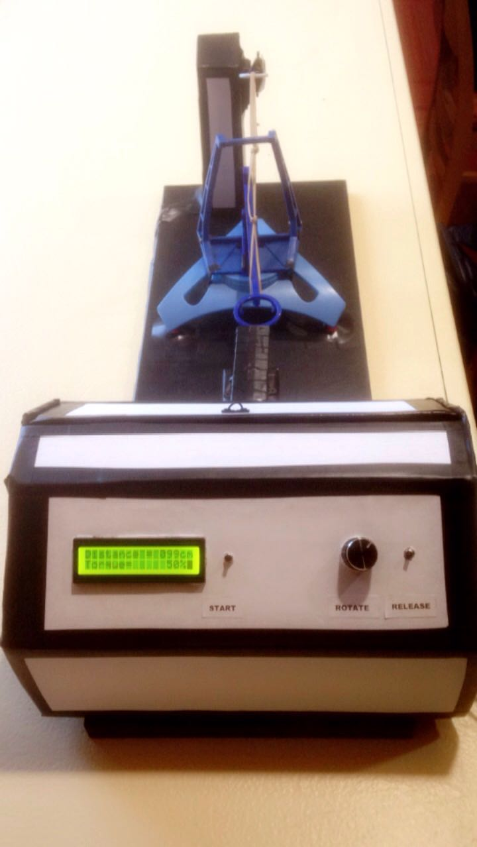
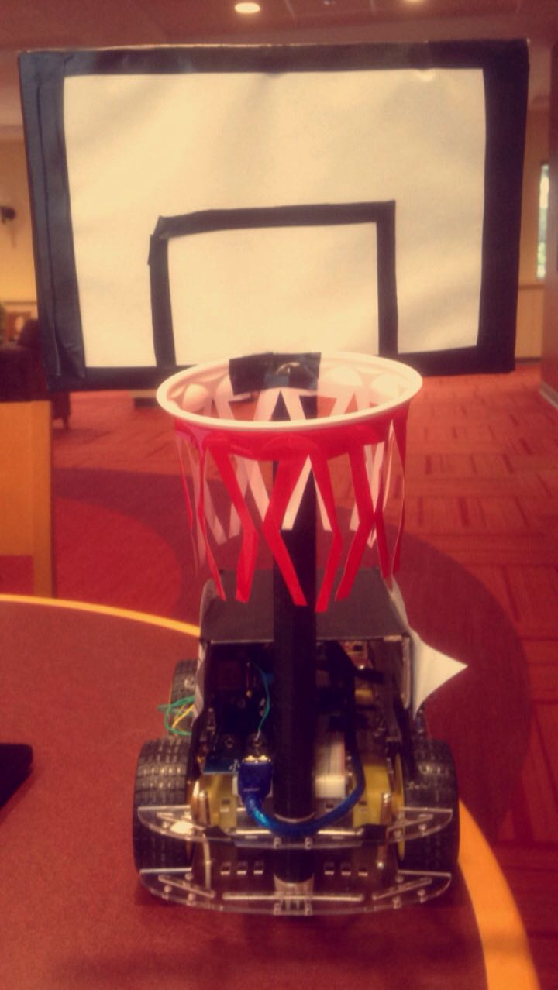
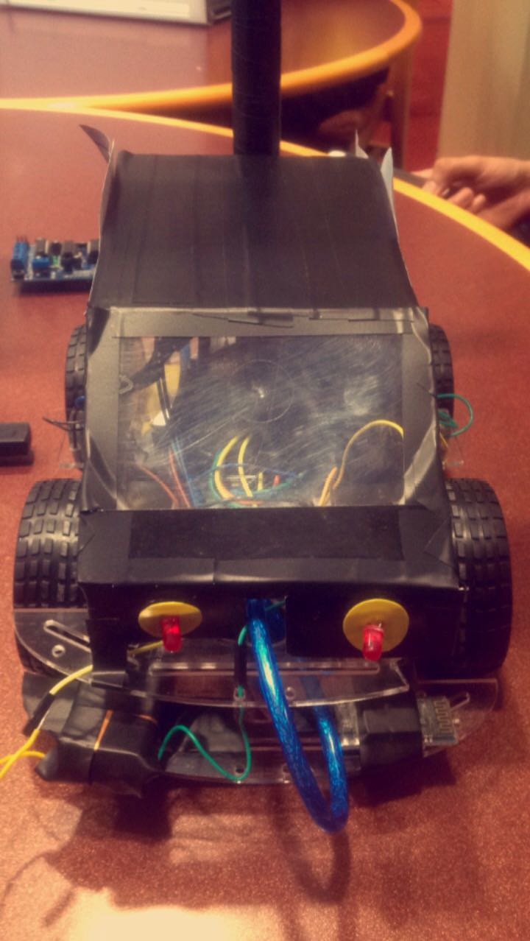
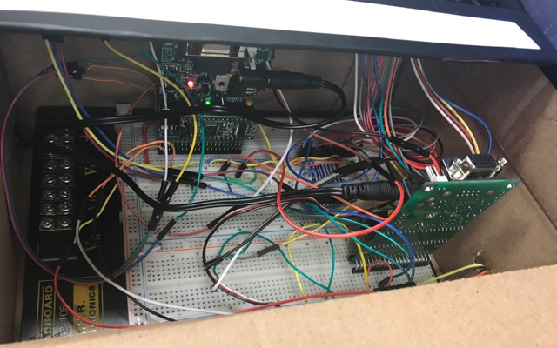
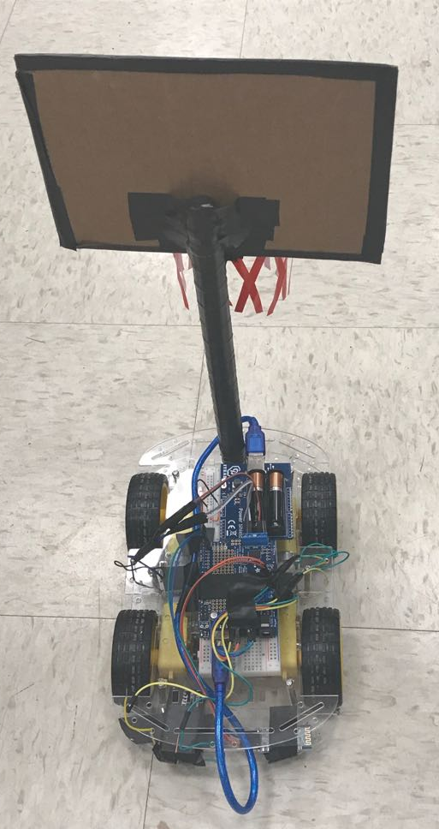

ECE 362 Embedded Microcontroller Mini-Project − Spring 2017
Team 11 “The Mini Hooper” – Interactive Basketball Game
Vaibhav Ramachandran, Athmaram Swaminathan, Rochak Chandra, Milind Shyam
Overview
Team 11: Vaibhav, Athmaram, Rochak, Milind
9s12c Code Flowchart
The Mini Hooper is an interactive basketball game wherein the user can use a catapult to toss a ball a certain distance depending on the torque given to the servo motor. The ball can be caught by a basket attached to a small Arduino based Bluetooth controlled car which the user can also control via an Android app on their phone.
9s12c Circuit schematic and design
Arduino Circuit schematic and design
The Mini Hooper
Placed on top of Arduino Uno
Component List
-9s12c microcontroller -Arduino UNO
-2 servo motors -Motor shield
-2 pushbuttons -Car chassis
-Potentiometer -4 DC motors
-LCD display -Bluetooth Module
-GAL device -Power shield
https://www.youtube.com/watch?v=k9LPc6AcZwU&feature=youtu.be
Digijock(ette)-Strength Digital System DesignTM

